Slide 1




Applications Development &
Emerging Technologies
Applications Development &
Emerging Technologies
Applications Development &
Emerging Technologies

Slide 2

Objectives
Explain the characteristics and differences between web, mobile, and emerging tech platforms
Describe how MIT App Inventor simplifies rapid prototyping
Identify and explain the phases of SDLC
Analyze ethical and legal issues in app development

Slide 3

Chapter 1. Introduction to Applications Development
Explain the characteristics and differences between web, mobile, and emerging tech platforms
Describe how MIT App Inventor simplifies rapid prototyping
Identify and explain the phases of SDLC
Analyze ethical and legal issues in app development
Objectives

Slide 4

What are Web Technologies?
Web technologies are the tools and techniques used to create websites and web-based applications that users access through a web browser (like Google Chrome, Mozilla Firefox, or Safari).
These technologies allow information and services to be delivered over the Internet without needing to install a separate app.
Web, Mobile, and Emerging Technologies

Slide 5

Web Technologies
Key Characteristics
Accessible through browsers – No need to download anything. Just type the URL (like www.facebook.com) and you're in.

Slide 6
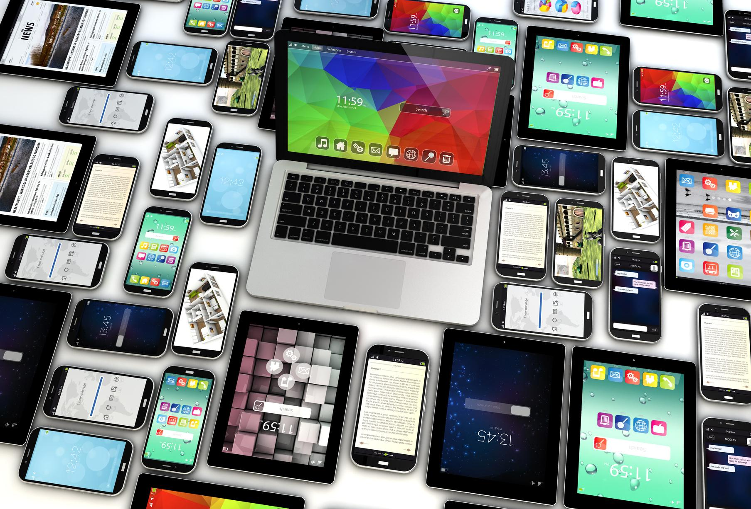
Key Characteristics
Works on all devices – You can access web apps from laptops, desktops, tablets, or phones.
Requires internet connection – Most web apps need a connection to function properly.
Web Technologies

Slide 7

Core Technologies Used
HTML (HyperText Markup Language)
The skeleton of the web. It structures the content (text, images, links).
Example: Creating paragraphs, headings, buttons.
Web Technologies

Slide 8

Core Technologies Used
CSS (Cascading Style Sheets)
The design part. It controls how things look (colors, fonts, layout).
Example: Making a red button, centering text.
Web Technologies

Slide 9

Web Technologies
Core Technologies Used
JavaScript
The brain or interactivity. It makes the page respond to user actions.
Example: Clicking a button to show a popup, or dynamically loading data.

Slide 10




Real-World Examples
Online Banking
www.bdo.com.ph
Lets you check balance, transfer funds.
E-commerce Site
www.shopee.ph
Browse, buy, and pay for products.
Web Technologies
Social Media
www.instagram.com
Connects users through posts and messages.

Slide 11
Web Technologies
Why Learn Web Technologies?
It’s the foundation of everything online.
Easy to start – even beginners can build a website in days.
Highly in-demand skills for careers in IT, media, and business.
Helps in building online portfolios, school projects, and more.

Slide 12
Web Technologies
Class Activity Idea
If you could make your own website, what would it be about? Why?

Slide 13



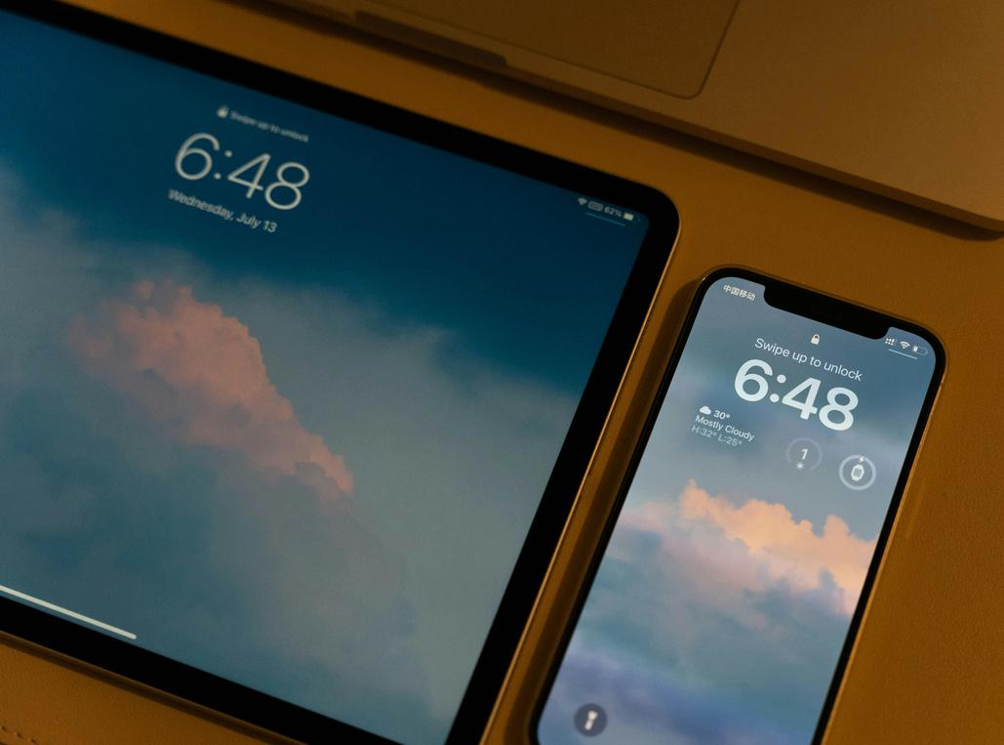
Mobile Technologies
What Are Mobile Technologies?
Mobile technologies refer to the tools, platforms, and systems used to develop applications (apps) that run on mobile devices such as smartphones and tablets.

Slide 14
Mobile Technologies
These apps are designed to be:
Touchscreen-friendly
Portable and fast
Integrated with mobile features (camera, GPS, contacts, notifications, etc.)

Slide 15
Mobile Technologies
Why Are They Important?
Most people today use mobile phones more than desktop computers.
Apps make life more convenient—whether it’s for communication, shopping, booking rides, learning, or entertainment.
Mobile development is a fast-growing job field (Android/iOS app developers).

Slide 16


Mobile Technologies
Mobile Platforms:
Two major platforms dominate mobile development:
Android – by Google
iOS – by Apple
Notes:
Each platform has its own:
Programming languages (e.g., Java/Kotlin for Android, Swift for iOS)
App stores (Google Play, Apple App Store)
Design guidelines and rules for app submission

Slide 17


Mobile Technologies
Types of Mobile Applications:
1. Native Apps
Built specifically for one platform.
Installed directly from an app store.
Have access to all device features
(camera, GPS, push notifications).
Usually faster and more reliable.
Example:
TikTok on Android is built using Kotlin or Java; TikTok on iPhone is built using Swift.

Slide 18

Mobile Technologies
2. Web Apps
Not installed; accessed using a browser (like a mobile-friendly website).
May not work offline or have full access to device features.
Easier to build and maintain across platforms.
Example:
Facebook's mobile site (m.facebook.com) accessed via browser.

Slide 19
Mobile Technologies
3. Hybrid Apps
A mix of native and web apps.
Built using web technologies but packaged like native apps.
Example:
Instagram started as a hybrid app.

Slide 20
Mobile Technologies
Examples of Mobile Apps:
Grab
Android & iOS
Transportation, food delivery
TikTok
Android & iOS
Short video creation and sharing
Facebook
Android & iOS
Social networking, messaging
GCash
Android & iOS
Mobile wallet and payments
Google Maps
Android & iOS
Navigation and location tracking

Slide 21
Mobile Technologies
Class Activity Idea
What’s your most-used mobile app? What do you like about it?

Slide 22



Role of MIT App Inventor in Application Development
What is MIT App Inventor?
A free, cloud-based tool that allows users to build Android apps using a visual programming interface (drag-and-drop blocks).
Designed for beginners and educational use.

Slide 23
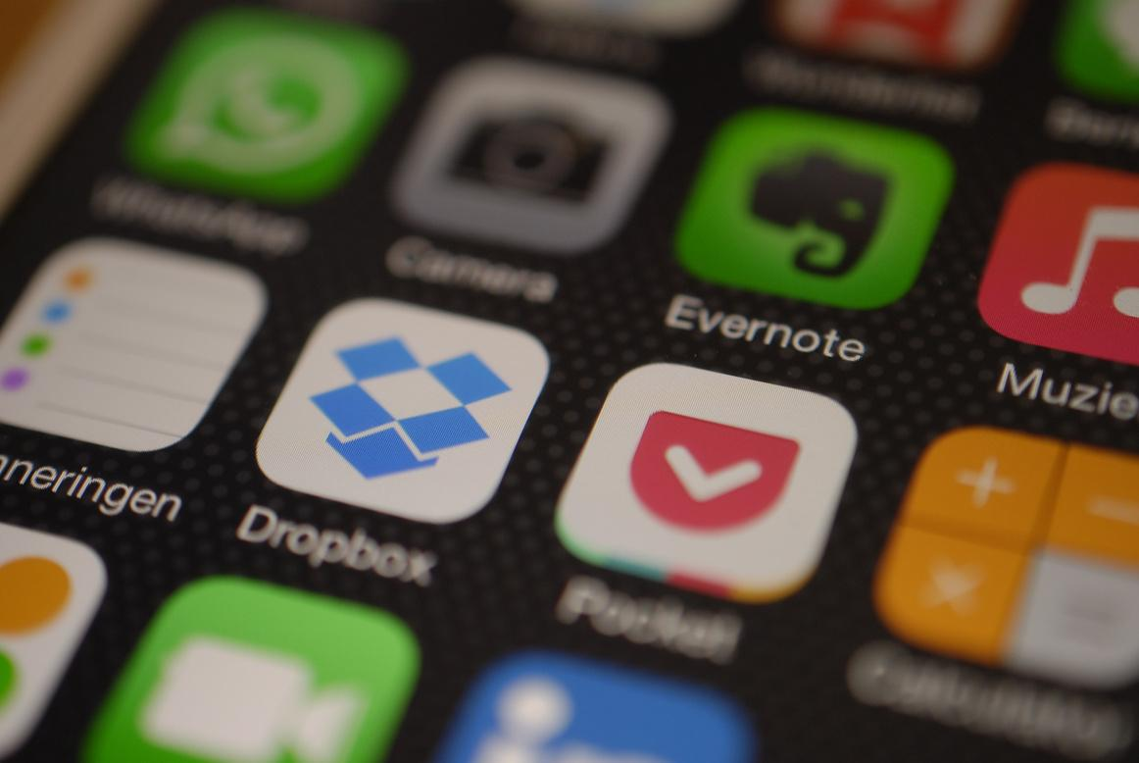

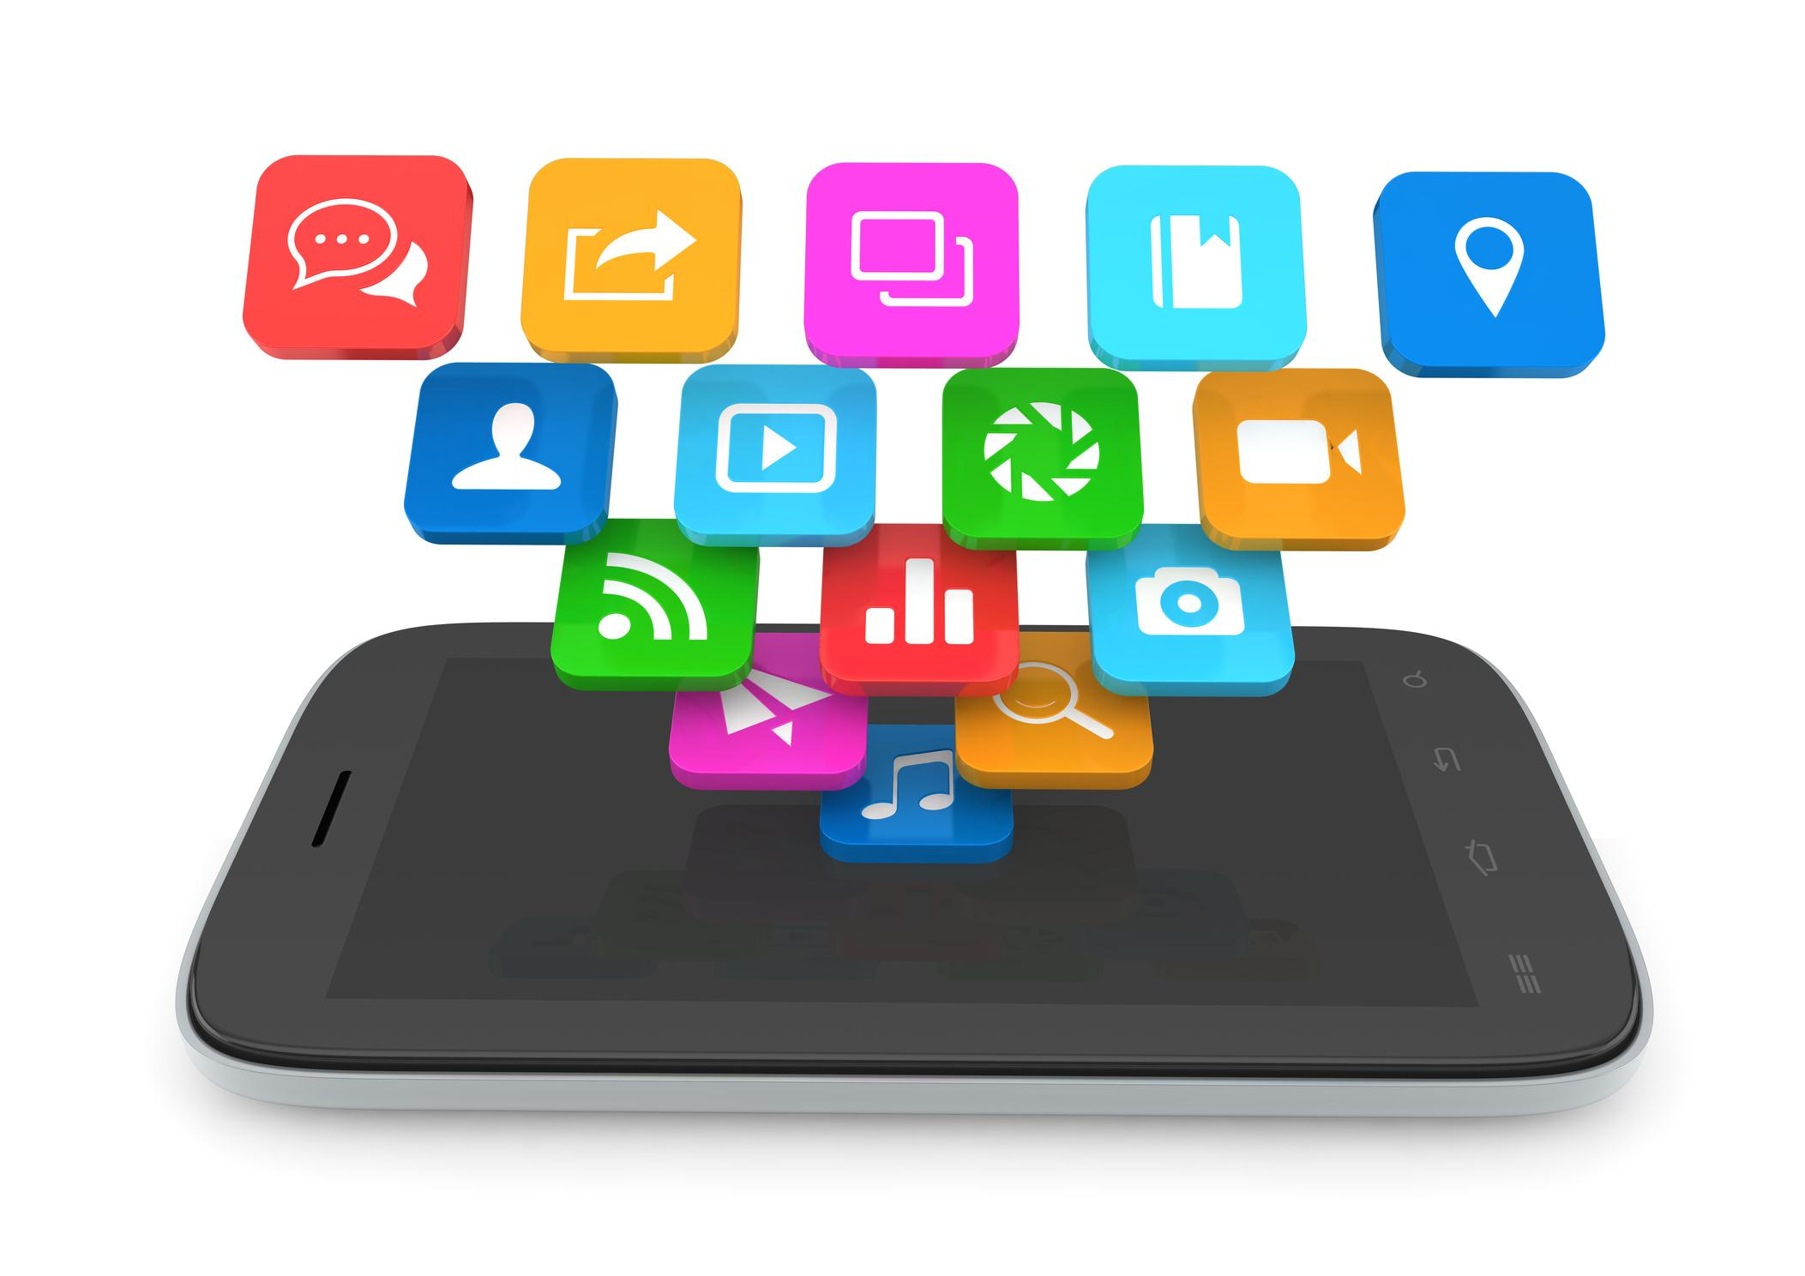
Rapid Prototyping:
Quickly building a working model of an app to test and improve ideas.
Helps students see results without needing to write complex code.
Encourages creativity and iteration (build → test → improve).

Slide 24
Why use it?
Visual and intuitive – great for learning logic and design.
Builds confidence in app development.
You can test apps on your phone using the AI Companion in real-time.

Slide 25
Real-world application:
Useful in classrooms, hackathons, student projects.
Good stepping stone to more advanced tools (like Android Studio or React Native).

Slide 26
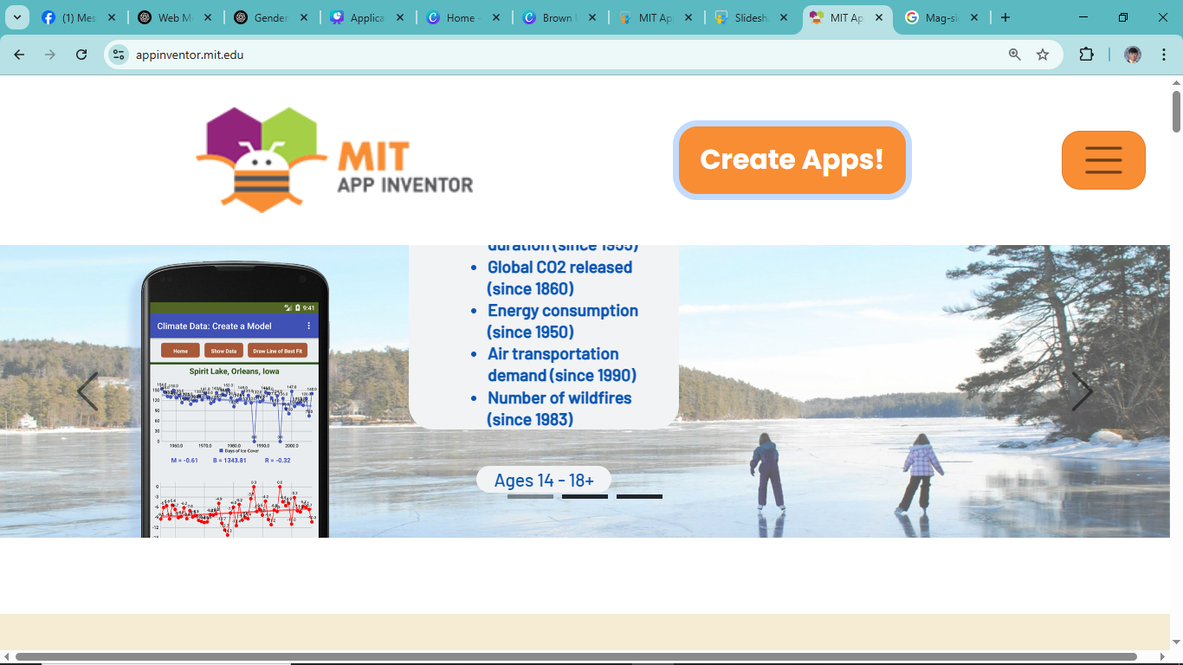

Log in/ Sign Up Using
Gmail

Slide 27
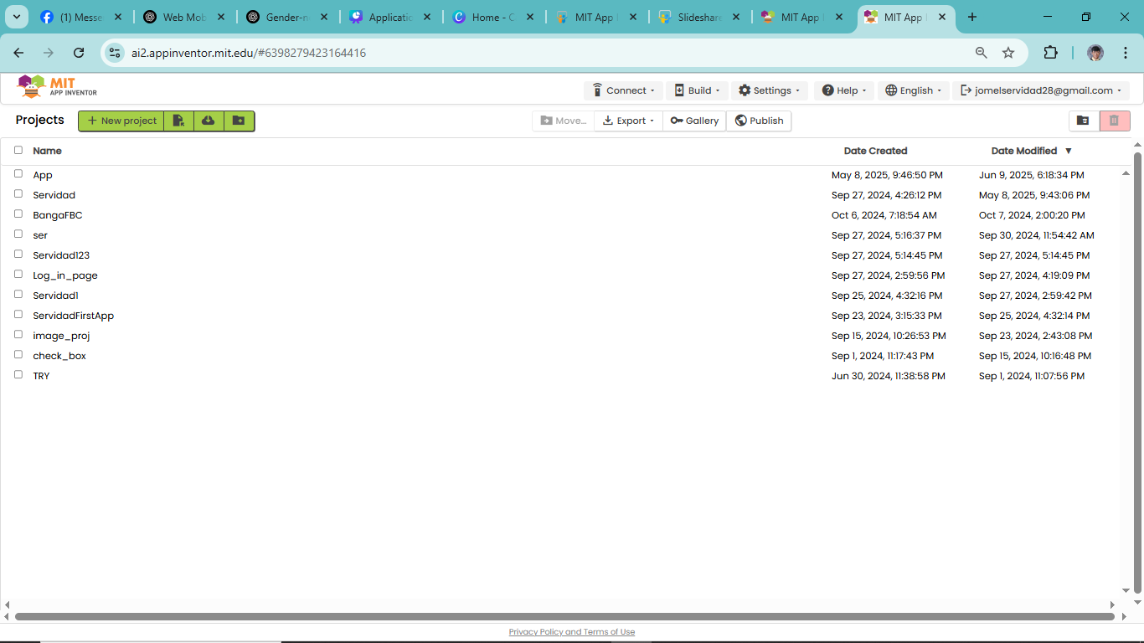
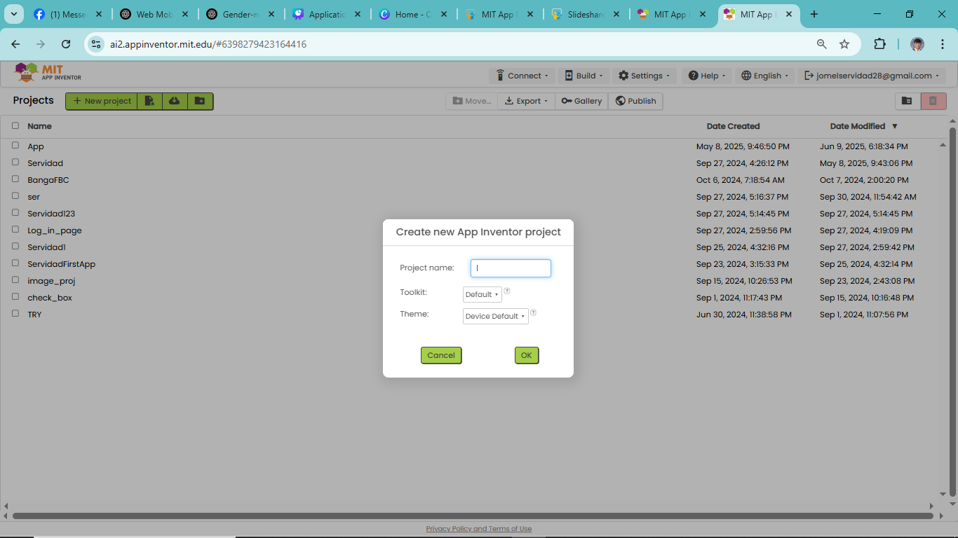

Slide 28
MIT APP INVENTOR 4 Parts
Palette
Viewer
Components
Properties

Slide 29
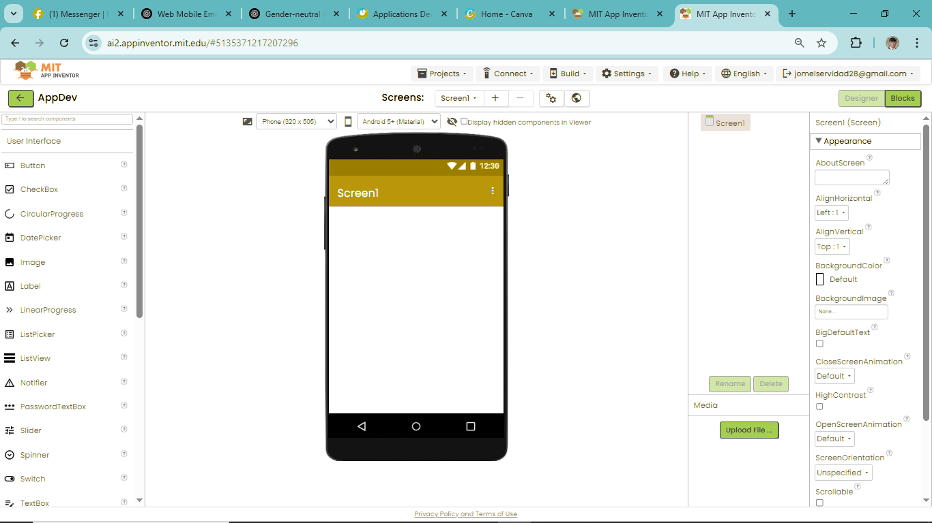





Components
Palette
Viewer
Properties

Slide 30
MIT APP INVENTOR 4 Parts
1. Palette
The Palette is where you find the tools to build your app — like buttons, labels, textboxes, sensors, and more.
It’s like your toolbox.
🔧 Example: You drag a Button from the Palette and drop it into your app screen.

Slide 31
MIT APP INVENTOR 4 Parts
2. Viewer
The Viewer is the design area where you build your app layout.
It shows how your app will look on a phone or tablet.
🖼️ Example: After dragging a Button from the Palette, it appears in the Viewer so you can position it.

Slide 32
MIT APP INVENTOR 4 Parts
3. Components
Components are the items (like buttons, labels, or sensors) that you’ve added to your app.
They appear in a list so you can easily manage them.
📋 Example: If you have a button and a label on your screen, both will show up in the Components panel.

Slide 33
MIT APP INVENTOR 4 Parts
4. Properties
Properties let you customize each component — change the text, size, color, font, alignment, etc.
🎨 Example: You can change the Button's text to say “Submit” or change its background color to blue.

Slide 34
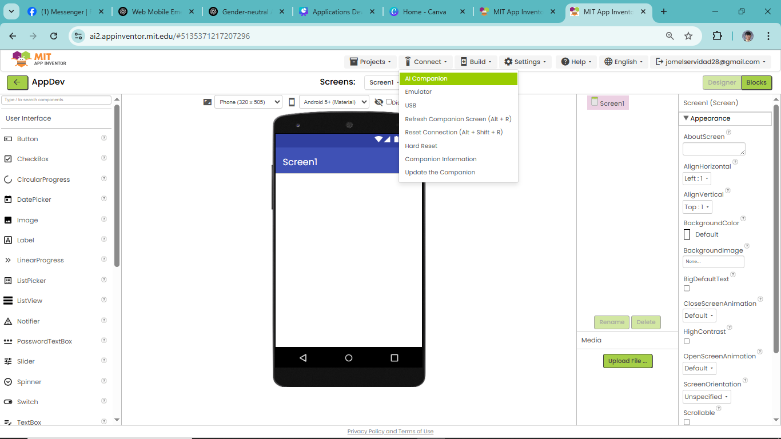
MIT APP INVENTOR 4 Parts
How to Test your App
Install MIT AI2 Companion
Click the Connect Tab & Click AI Companion

Slide 35
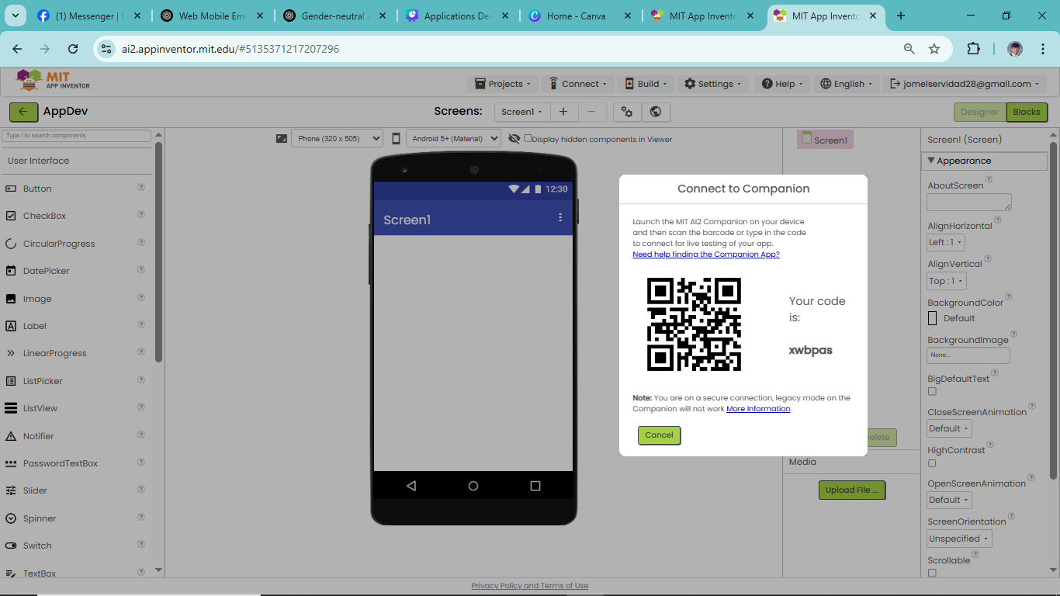


MIT APP INVENTOR 4 Parts
How to Test your App
3. Scan the QR Code using your MIT AI2 Companion
App or You can
just Enter the
Code and see
the Magic

Slide 36
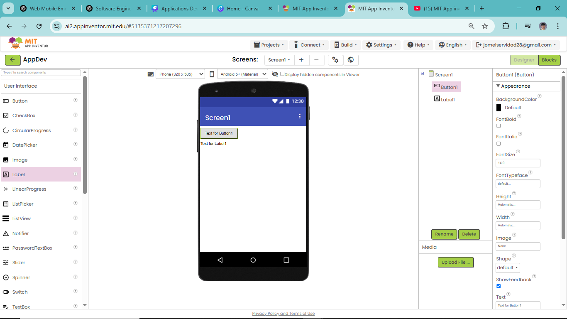
MIT APP INVENTOR
Drag 1 button and 1 Label

Slide 37
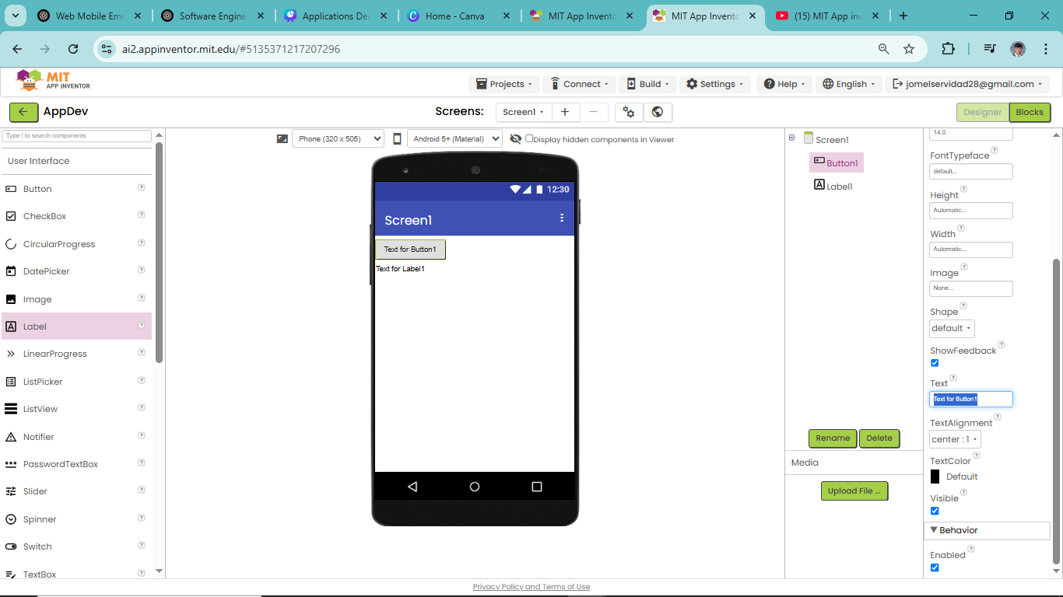



MIT APP INVENTOR
Click the Button in the Components to Change its Properties

Slide 38
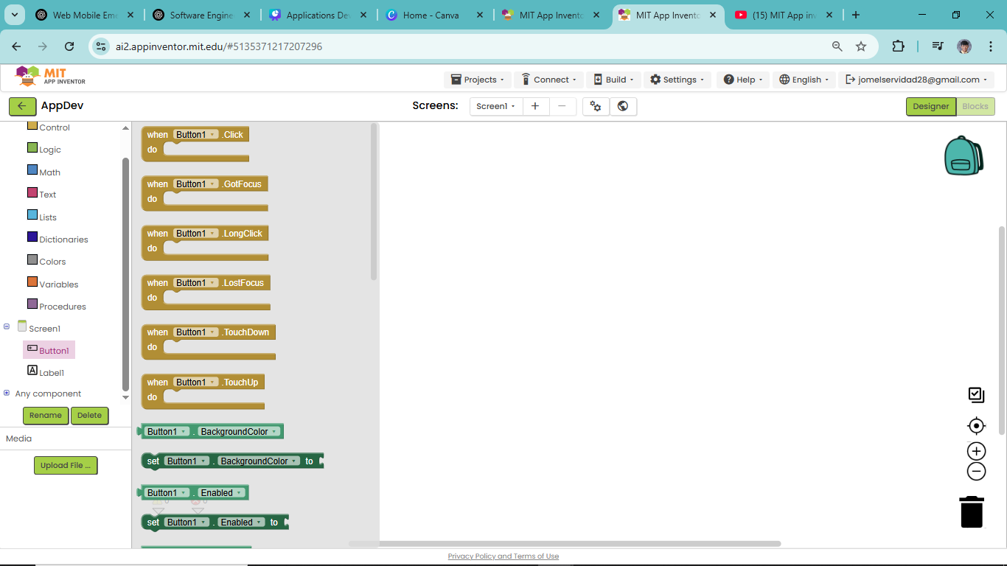

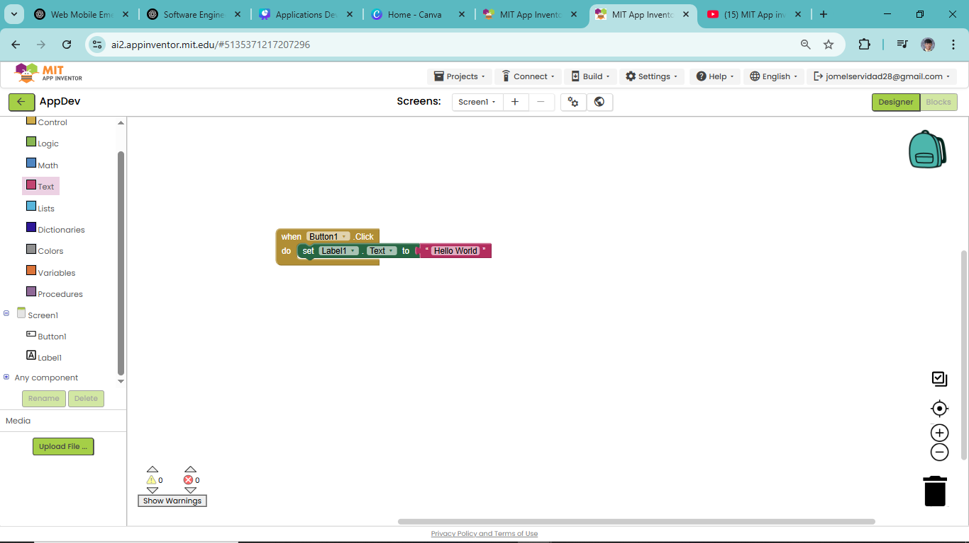
MIT APP INVENTOR

Slide 39
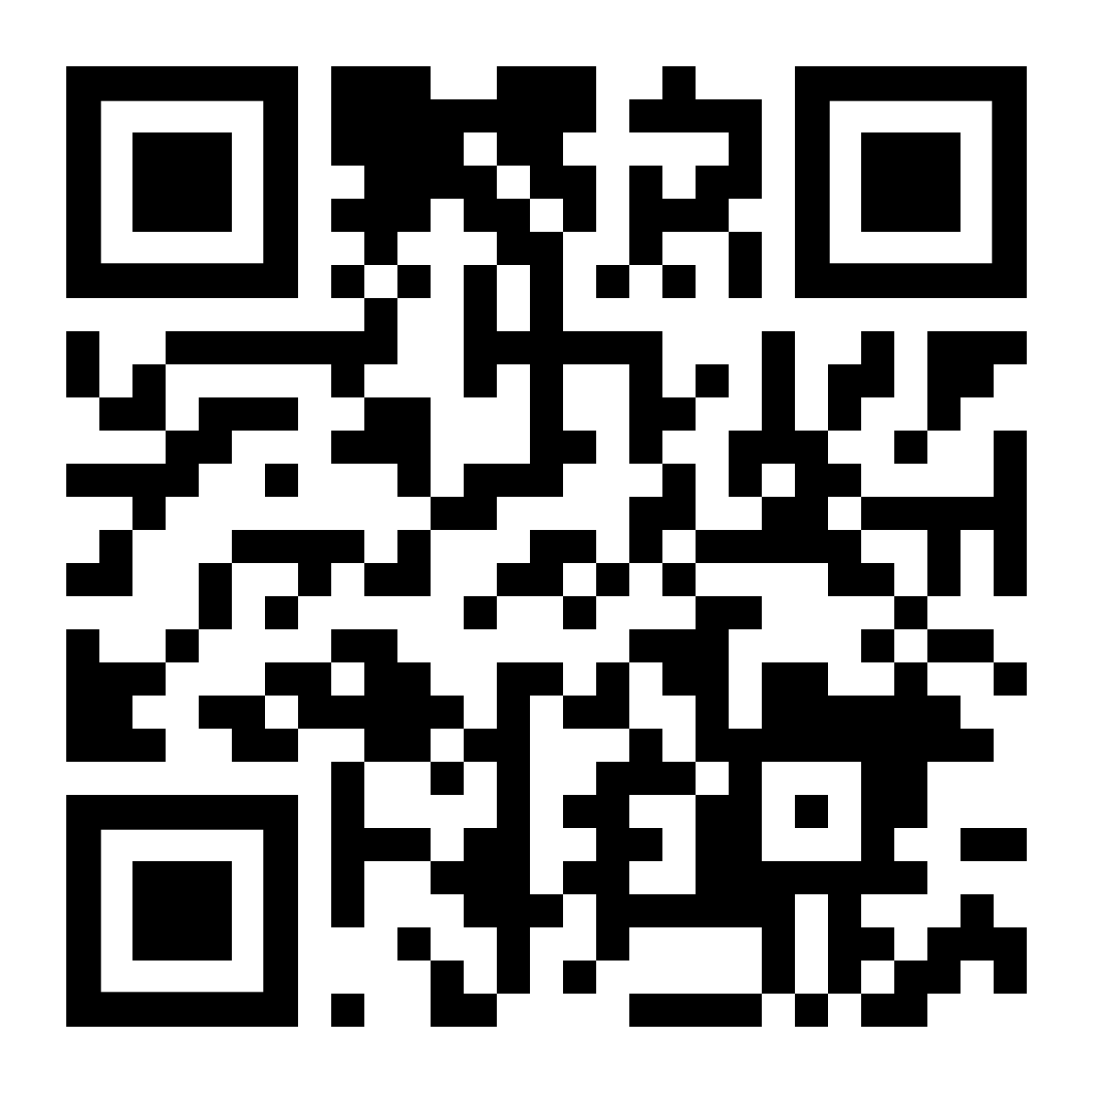
Activity 1
Install an app in Playstore/appstore called “MIT AI2 Companion”
Scan the QR Code and access the lab instructions

Slide 40
Ethical and Legal Considerations in App Development (Data Privacy, Accessibility)
To help students understand their responsibilities as future app developers—not just in terms of coding, but in making decisions that respect people’s rights, safety, and dignity.

Slide 41

Ethical and Legal Considerations in App Development (Data Privacy, Accessibility)
1. Data Privacy
means protecting personal information that users share with your app. This includes names, phone numbers, addresses, passwords, photos, GPS location, payment info, and more.
Why is it important?
Users trust your app with their information. If that data gets stolen, leaked, or misused, it can lead to identity theft, scams, or even real-life danger.

Slide 42

Ethical and Legal Considerations in App Development (Data Privacy, Accessibility)
What developers must do:
Minimize data collection: Only ask for what’s truly necessary (don’t collect birthdays if you just need an email).
Encrypt data: Protect stored or transmitted data from hackers.
Ask for permission: Always ask users before accessing sensitive information like location, contacts, or camera.
Give control: Let users edit or delete their data if they want.

Slide 43
Ethical and Legal Considerations in App Development (Data Privacy, Accessibility)
Legal Compliance:
Data Privacy Act of 2012 (Philippines):
Sets rules for collecting, processing, and storing personal data.
Violators may face legal action and penalties.
Example:
If your app asks to access a user's photos, you must explain why and let them say "yes" or "no."

Slide 44

Ethical and Legal Considerations in App Development (Data Privacy, Accessibility)
Other Ethical Concerns
Intellectual Property (IP)
Don’t copy designs, icons, code, or ideas from other apps without permission.
Respect copyright and licenses.
Give credit if you use open-source materials.

Slide 45

Ethical and Legal Considerations in App Development (Data Privacy, Accessibility)
Other Ethical Concerns
Transparency and Honesty
Be upfront about what your app does.
Don’t include hidden trackers, data collection, or “dark patterns” that trick users.
Let users know if something is an ad or a paid feature.

Slide 46

Introduction to SDLC (Software Development Life Cycle)
SDLC is a structured process that developers follow to create high-quality software or applications in a systematic and efficient way.
Think of it like building a house—you don’t just start hammering wood. You plan, design, build, test, and maintain it properly. That’s exactly what SDLC does for apps and software.

Slide 47
Introduction to SDLC (Software Development Life Cycle)
SDLC is a structured process that developers follow to create high-quality software or applications in a systematic and efficient way.
Think of it like building a house—you don’t just start hammering wood. You plan, design, build, test, and maintain it properly. That’s exactly what SDLC does for apps and software.

Slide 48

Introduction to SDLC (Software Development Life Cycle)
Why is SDLC Important?
✅ Makes development organized and predictable
✅ Saves time, money, and effort
✅ Helps the team understand what to build and how to build it
✅ Reduces errors, miscommunication, and rework
✅ Ensures the app truly solves the user's problem

Slide 49
Introduction to SDLC (Software Development Life Cycle)
Basic Stages of the SDLC
Here are the 7 main stages of the SDLC explained simply:
Planning – Identify the need or problem; set goals.
Requirements Analysis – Gather requirements from users and stakeholders.
Design – Create wireframes, flowcharts, or mockups of the app.
Development – Start coding or building the app.
Testing – Check for bugs or issues; ensure everything works correctly.
Deployment – Release the app to users.
Maintenance – Update the app, fix bugs, add features.

